Slide 1
Discrete Mathematics Course Introduction
by Akkradach W.
Dept. of Computer Engineering
KMITL

Slide 2
Goals
Mathematical Reasoning (proofs)
Combinatorial Analysis (enumeration)
Discrete Structures (abstract data)
Applications and Modeling (problem-solving)

Slide 3
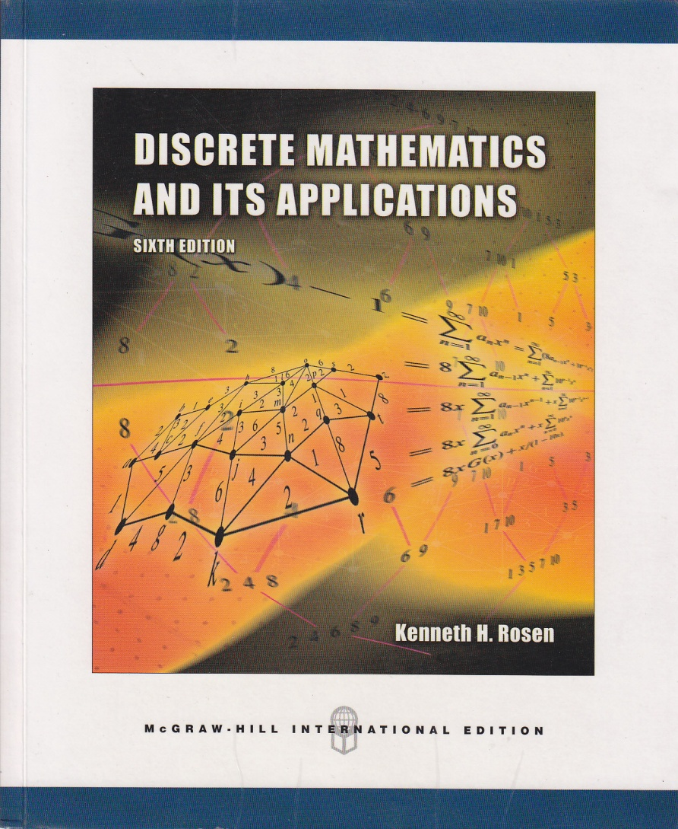
Textbook (must have)
Discrete Mathematics and Its Applications 6th Edition
(International Edition)
ISBN 9780071244749
by Kenneth H. Rosen

Slide 4
Schedule (1/2)
#1 Chapter 2 - Basic Structures: Sets, Functions, Sequences, and Sums
Chapter 11 - Boolean Algebra
#2 Chapter 1 - Foundations: Logic and Proofs
#3 Chapter 4 - Induction and Recursion Chapter 5 - Counting

Slide 5
Schedule (2/2)
#4 Chapter 7 - Advanced Counting Techniques
Chapter 8 - Relations
#5 Chapter 9 - Graphs
#6 Chapter 10 - Trees
#7* Selected topics in Number Theory

Slide 6
Scoring
Assignment #1 5%
Assignment #2 5%
Assignment #3 5%
Assignment #4 5%
Midterm Exam (A4) 30%
** SEPARATED from Finite Automata **

Slide 7
Styles
Lecture (~2hr)
Problem-based Instruction (~1hrs)
Self-Study (before class)
Student Driven (Group Presentation)
Research-based Instruction (uno)
“Pi”
Project-based Instruction (duo/trio)
Programming Assignments

Slide 8
Assignments
Pi
Numerical Methods
Newton-Raphson method
Monte Carlo Integration
Least Squares
Pseudo-Random Number Generators
Dijkstra's Algorithm

